Slide 1


Slide 2

Analysis of Video Surveillance in the bank using Machine Learning
Group Member Names:
Neha Sirurmath
Vaibhav Wable
Vidyasagar More
Dr. D.Y. Patil Institute of Technology, Pimpri,Pune.
Department of Computer Engineering
Guide:
Prof. Jithina Jose

Slide 3
Agenda
Introduction
Challenges
Objectives
Literature Survey
Problem Statement
Solution Proposed
Requirement Analysis
Algorithm
Results
Conclusion
Future Work
References

Slide 4
INTRODUCTION
Video Surveillance is an act of observing or looking for something improper. This video surveillance is used in Banks for anomalous detection. Anomalous detection is identifying unexpected events that differ from normal events.
It is very useful in banks to control, monitor and investigate Criminal activities.
This innovative video surveillance is used in the banking sector for not only high-security levels but also to solve financial problems.

Slide 5
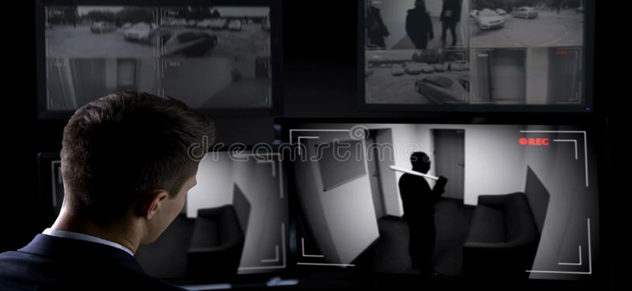
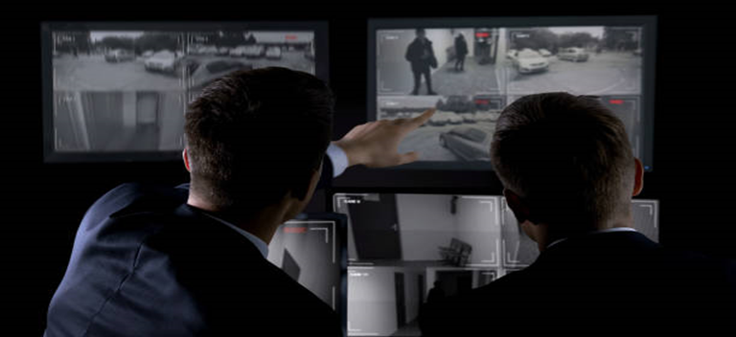
Figure1:
Anomalous detection

Slide 6
OBJECTIVES
Surveillance cameras are increasingly being used in public places in streets, intersections, banks, shopping malls, etc. to increase public safety.
One critical task in video surveillance is detecting anomalous events or illegal activities.
Develop an intelligent Model for automatic video anomaly detection which would save time.
Therefore anomaly detection in bank sectors can be considered as coarse-level video understanding, which filters out anomalies from normal patterns.

Slide 7
LITERATURE SURVEY
Sr no | IEEE Paper | Authors | Advantages | Future work
1 | https://ieeexplore.ieee.org/document/6751449 | Cewu Lu , Jianping Shi ,jiaya jia. | they have presented an abnormal event detection method via sparse combination learning and the model is very much faithful input data when compared with original sparse data and the model is verified by a large number of videos. the method is robust that distinguishes between abnormal patterns and normal patterns | Their future work is to extend the sparse combination learning framework to other video applications.

Slide 8
Sr no | IEEE Paper | Author | Advantages | Future work
2. | https://www.researchgate.net/publication/239943156_Anomaly_Detection_and_Localization_in_Crowded_Scenes | Wei-Xin LI, Vijay Mahadevan | This IEEE paper is based on joint detection and has proposed spatial anomalies. They proposed anomaly detection that spans spatial scale, time, and space too. They have Used MDT models | Future work is to improve frame-level and pixel-level

Slide 9
Sr no | IEEE Paper | Author | Advantages | Future work
3. | https://ieeexplore.ieee.org/document/7780455 | Mahmudul Hasan,Jonghyun Choi, Jan Neumann,Amit K. Roy-Chowdhury. | This IEEE paper approaches a problem that is difficult in perceiving meaningful activities in a very long video. They have learned a model which needs very limited supervision. They have proposed two methods which are built on autoencoders and no supervision is needed | learned models in a number of ways such as visualizing the regularity in frames and pixels and predicting a regular video of past and future given only a single image

Slide 10
Sr no. | IEEE Paper | Author | Advantages | Future Work
4. | https://ieeexplore.ieee.org/document/4407716 | Amit Adam, Ehud Rivlin,Iian Shimshoni,Daviv Reinitz | In this paper they have presented an algorithm for abnormal events detection called multiple local monitors here alerts are generated by each local monitor and are attached to the final result. when an abnormal event is detected alerts are generated. | The limitation of the algorithm is that it lacks sequence monitoring and is not suitable for large-scale video surveillance projects.

Slide 11
Sr no | IEEE Paper | Author | Advantages | Future Work
5. | https://ieeexplore.ieee.org/document/7410867 | Du Tran,Lubomir Bourdev,Rob Fergus,Lorenzo Torresane,Manohar Palhuri. | In this paper they have addressed the problem of learning spatiotemporal features using 3D ConvNets.and they are trained on large-sized video datasets. they have also found 3D ConvNets temporal kernel length. | They help to solve large problems such as action recognition, and abnormal event detection.

Slide 12
Sr no | IEEE Paper | Author | Advantages | Future work
6. | https://ieeexplore.ieee.org/document/6182132 | N Bird,S.Atev,N .Camaelli,R.Martin | intelligent video surveillance system has good application prospect in security field, the detection, tracking and classification of target are key parts of the system | The whole monitoring system is also constrained by two major difficulties, which can easily deal with complex environments and explore a variety of changes,

Slide 13
PROBLEM STATEMENT
Bank is using video cameras for the purpose of surveillance at many branches.ATMs and digital lobbies. Getting video analytics of different parameters from the video recording will help the bank to resolve many operational issues at the branches.The bank wants to explore video analytics for understand the customer behaviors or actions in certain branches for proactive surveillance and provide beter service to customers.

Slide 14
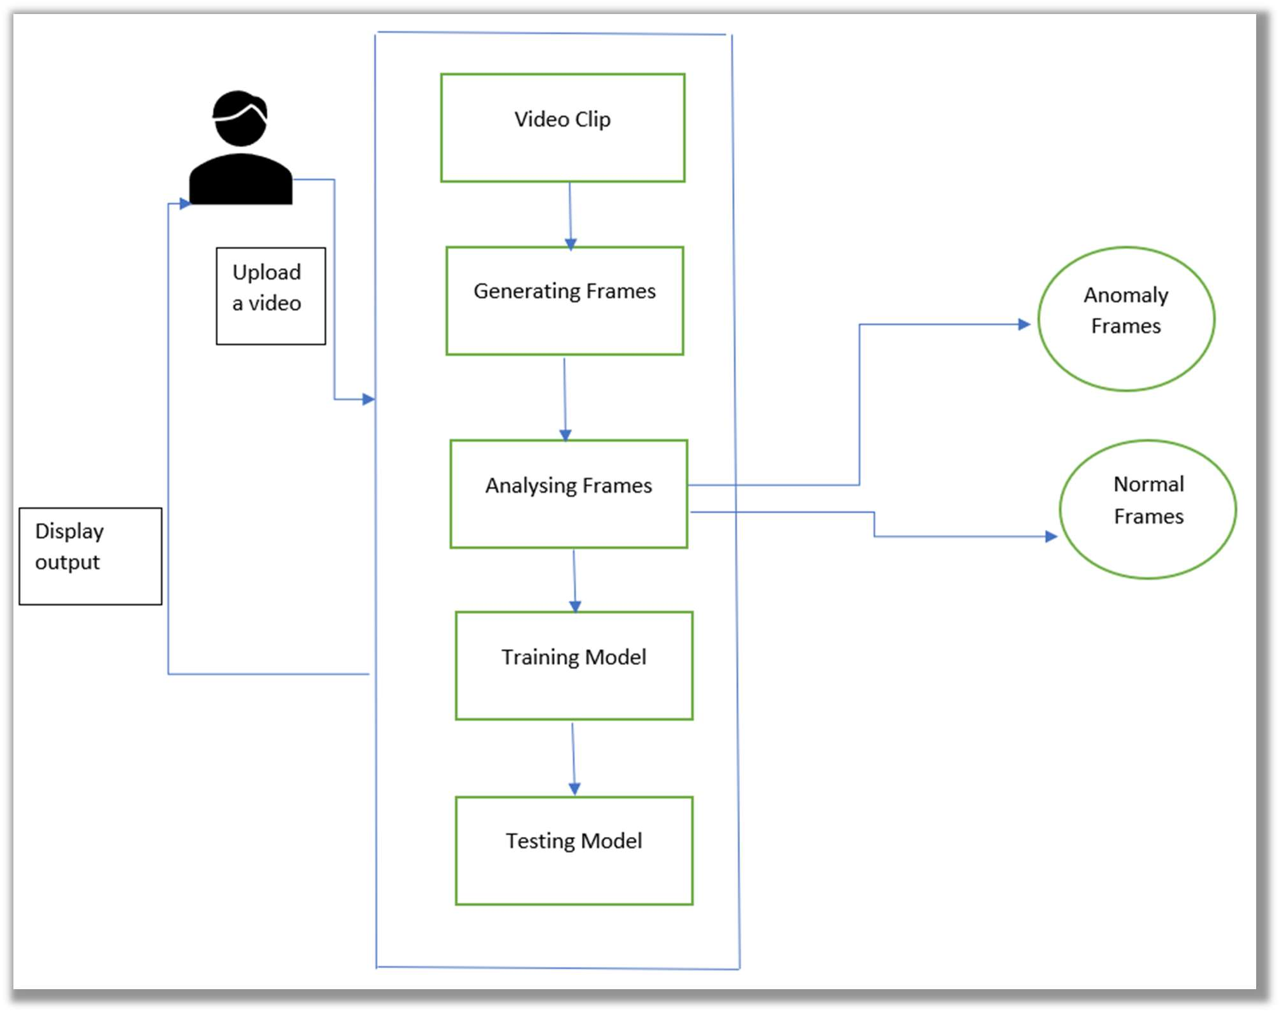
SOLUTION PROPOSED

Slide 15
Frontend consist of html/css having home page for a user to upload a video .
Home page has links for Attachments, Contacts and About.
User can choose a video file and upload it, while it process in the background by a Machine learning model.
In the backend video file gets processed and once the processing is complected user is redirected to result page to view the file whether it contains normal activities or abnormal activities.
User can also view and download the file for his/her need.

Slide 16
REQUIREMENT ANALYSIS
HARDWARE REQUIREMENTS
System Processor:Core2Duo
Speed:2.4 GHz
Hard Disk:150 GB
SOFTWARE REQUIREMENTS
Operating System: 64bit windows 10
Framework: Django
IDE : Jupyter Notebook , pycharm
Back-end : Django , python
Database –Directory repository
Front-end- chrome browser

Slide 17
ALGORITHM
CNN Convolutional Neural Network
A convolutional neural network CNN or convent is a subset of Machine Learning. It is one of the various types of artificial neural networks which are used for different applications and data types.

Slide 18
A deep-learning CNN consists of three layers:
a convolutional layer
a pooling layer
a fully connected (FC) layer.
The convolutional layer is the first layer while the FC layer is the last.
From the convolutional layer to the FC layer, the complexity of the CNN increases.
It is this increasing complexity that allows the CNN to successfully identify larger portions and more complex features of an image until it finally identifies the object in its entirety.
Convolutional layer. The majority of computations happen in the convolutional layer, which is the core building block of a CNN. A second convolutional layer can follow the initial convolutional layer.
Pooling layer. the pooling layer also sweeps a kernel or filter across the input image. But unlike the convolutional layer, the pooling layer reduces the number of parameters in the input and also results in some information loss. On the positive side, this layer reduces complexity and improves the efficiency of the CNN.
Fully connected layer. The FC layer is where image classification happens in the CNN based on the features extracted in the previous layers. Here, fully connected means that all the inputs or nodes from one layer are connected to every activation unit or node of the next layer.

Slide 19
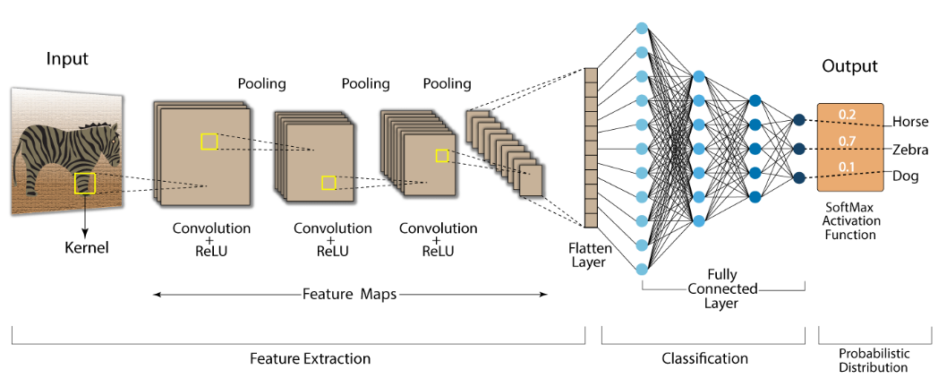
CNN CONVOLUTION NEURAL NETWORK

Slide 20

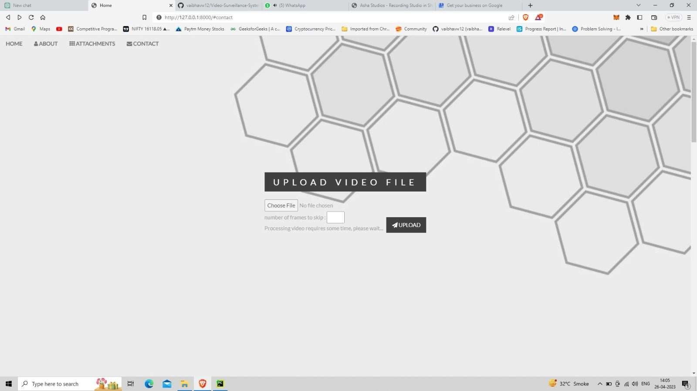
RESULTS
Home page

Slide 21


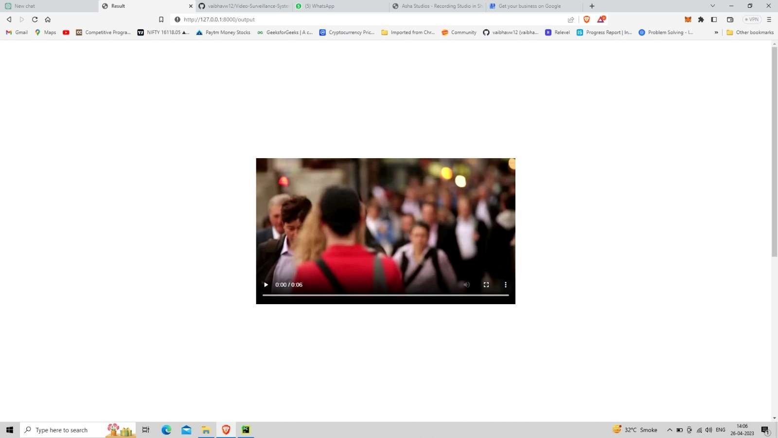
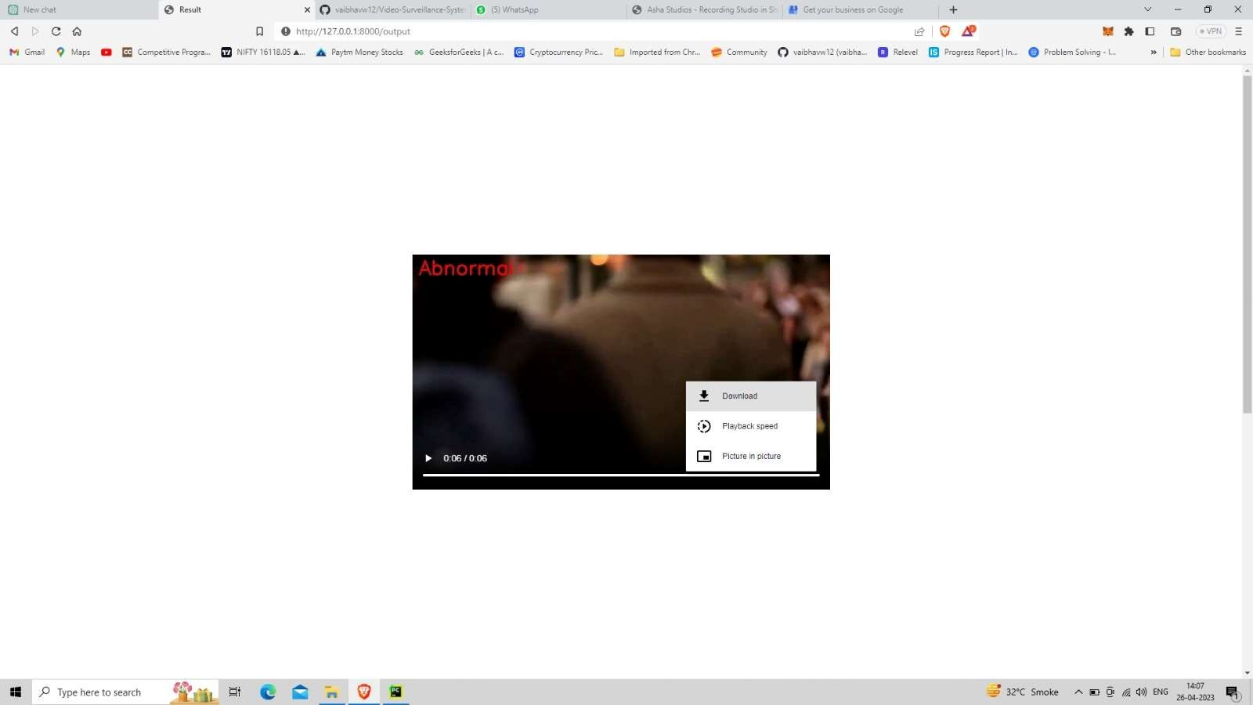
Abnormal Output
Normal Output

Slide 22
CONCLUSION
The research work carried out would focus to design and develop a video surveillance system to solve security problems which will help to reduce abnormal events that take place in banks.
The system will capture the abnormal task from the frames of videos which is given as input to the model and generates an alarm. After successfully implementing the project it can be used in banks, home security systems, museums, and streets at midnight.

Slide 23
APPLICATIONS
1. Security spy cameras
2. Use in Banks, ATMs, Hospitals, and Government Buildings.
3. Use in Military related applications.
4. Personal use such as for private households.
5. Shopping malls, Cinema halls, jewelry shops,etc.
6. Analysis of human behavior for anomaly detection.
7 Prediction of the anomalies in the scene.

Slide 24
FUTURE WORK
one can categorize Video Surveillance Systems based on the type of imaging modality acquired, producing categories like “one camera systems”, “many camera systems”, “fixed camera systems”, “moving camera systems” and “hybrid camera systems”.
Video Surveillance Systems can be categorized based on the architecture a system is built on, such as stand-alone systems, cloud-aware systems, and distributed systems

Slide 25
ACKNOWLEDGEMENT
We would like to express our deepest gratitude to all those who provided us with the possibility to complete this task. Special gratitude to our project guide, Prof. Jithina Jose Mam, whose contribution in stimulating suggestions and encouragement, helped us to coordinate our project. We also appreciate the guidance given by panel members which helped us to improve our presentation and thanks to their comments and advice. We are also thankful to our parents who provided their wishful support for our project completed successfully. And lastly, we thank our all friends and the people who are directly or indirectly related to our project work.

Slide 26
Thank you

